Slide 1
Research with Dr. Richard
Christian Henke
Fall 2020 semester

Slide 2
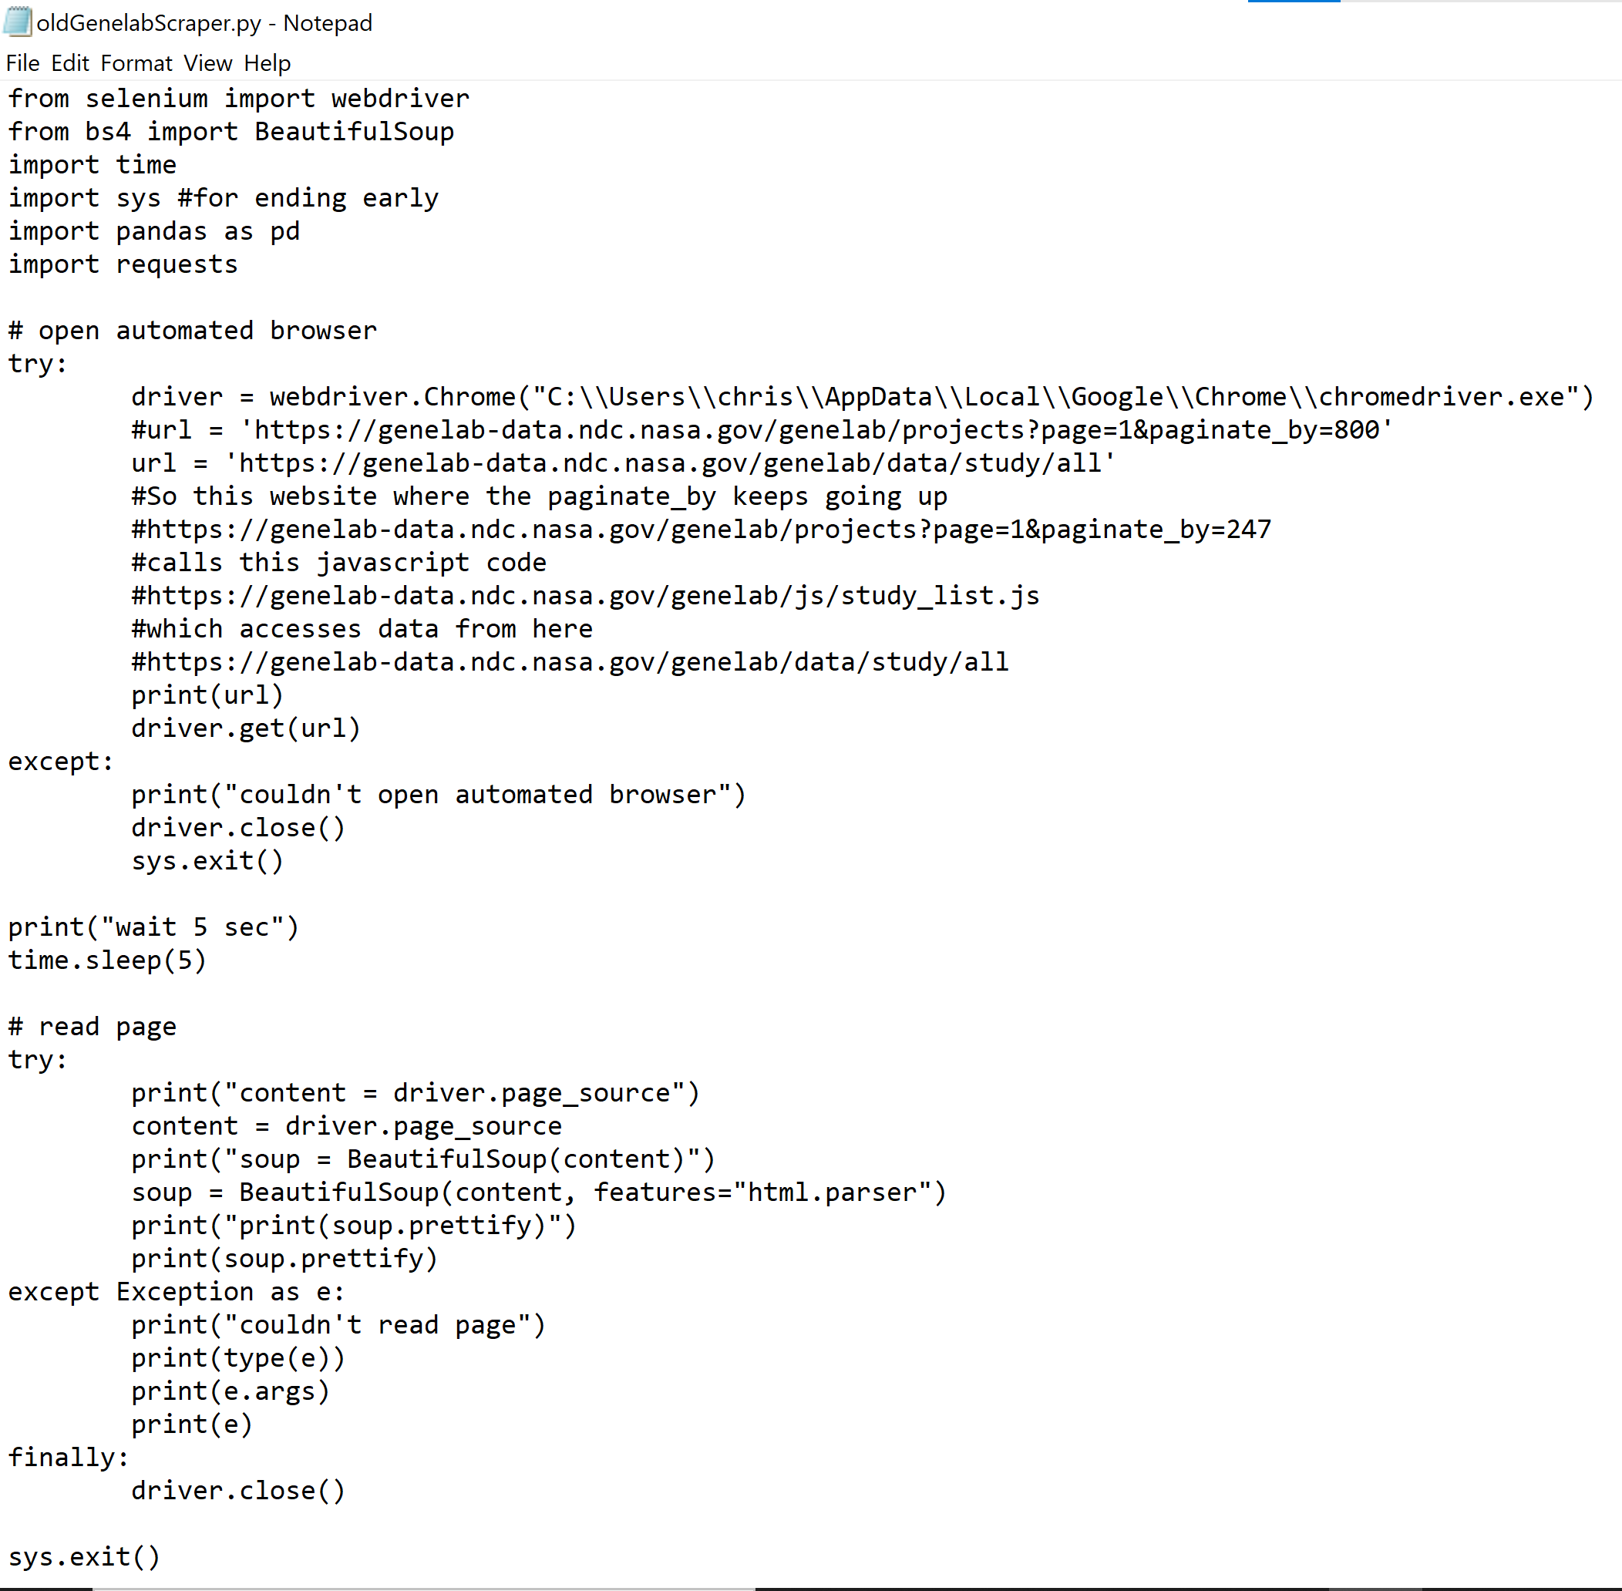
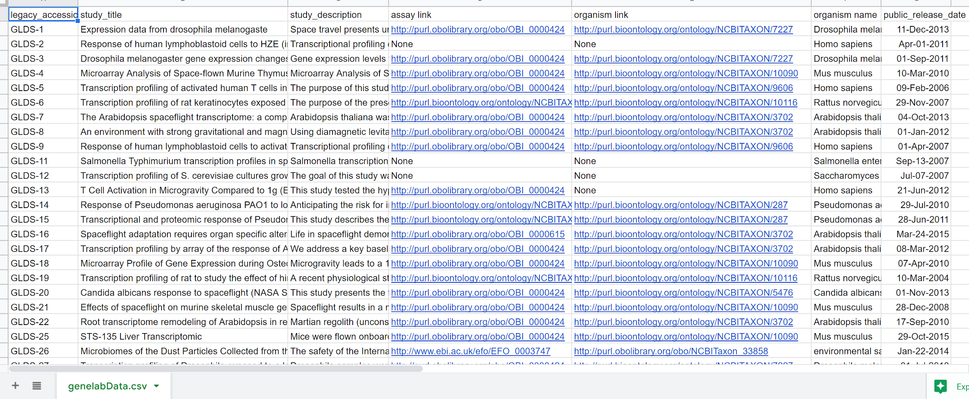
Quick precursor - last semester
Notes:
Just a little background info.
I made the old GenelabScraper in python, part of it shown on the left here,
outputted some of the data in a table, partly shown on the right

Slide 3
This semester

Slide 4
Second quick precursor - Tech tangents
Get Epicollect data into Qlik
Get 400+ microbiomes’ data from JPL from a Github, using the API or just downloading the CSV’s
Install RootNav2.0 on a server for public pic upload and automatic analysis, fix RootNav2.0 issue with Dr. Richard’s photos
Comment and change R Markdown scripts, related to the Archidart package, using RSML files
RootNav also, add it as part of an online pipeline
API tangents
Genelab API for some Genelab data
MGnify API for some analysis of microbiome data that Genelab is slow to do
Cyverse API, as another option for online RootNav2.0 automatic system

Slide 5
Okay now can we get started?

Slide 7
One more thing:

Slide 8
One more thing:
Why was the Arabidopsis thaliana on the catwalk?

Slide 9
One more thing:
Why was the Arabidopsis thaliana on the catwalk?
It’s a model plant

Slide 10
One more thing:
Why was the Arabidopsis thaliana on the catwalk?
It’s a model plant
All of the press wanted a PHOTOsynthesis

Slide 12
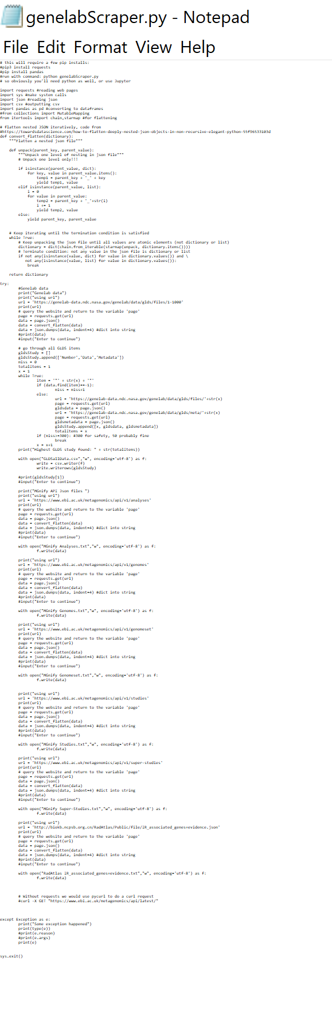
genelabScraper - new and improved!
Scrape all the JSON data from:
All GLDS data
Genelab data
Genelab metadata
MGnify Analyses
MGnify Genomes
MGnify Genomeset
MGnify Studies
MGnify Super-studies
RadAtlas IR_associated_genes +evidence

Slide 13
JSON data
Notes:
But what is this JSON data thing? Tell us, magic computer man!

Slide 14
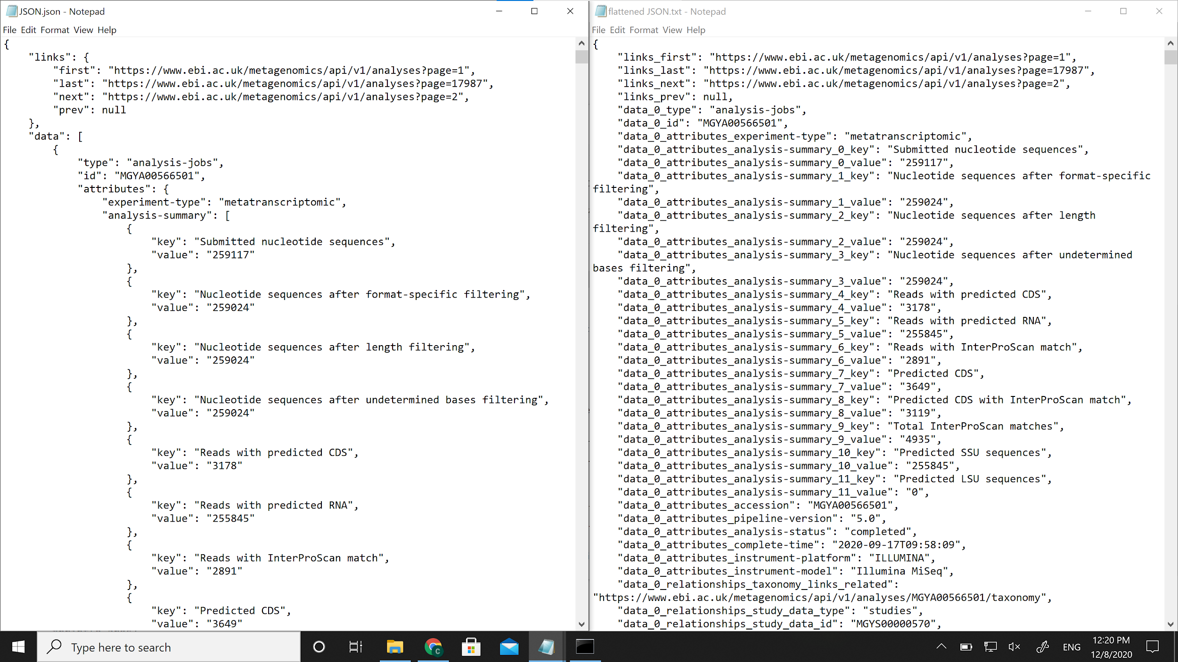
flattened JSON
JSON

Slide 15
So what to do? None of that data looks pretty

Slide 16
Options:
Flatten the JSON data into a few columns recursively, drop the left over JSON into a final column, give Dr. Richard such a table with the data
Flatten the JSON data with _, give Dr. Richard such a table with the data. Give just the JSON data if it doesn’t flatten
Translation: 2 different ways to change JSON into a table, which is better?

Slide 17
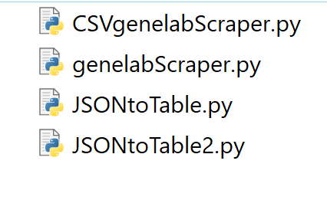
Answer? Don’t know! Do both.
2 scrapers that work the same but output data different
2 converter functions that take JSON and do one of the conversions

Slide 18
That was the brunt of the semester, but tangent!

Slide 19
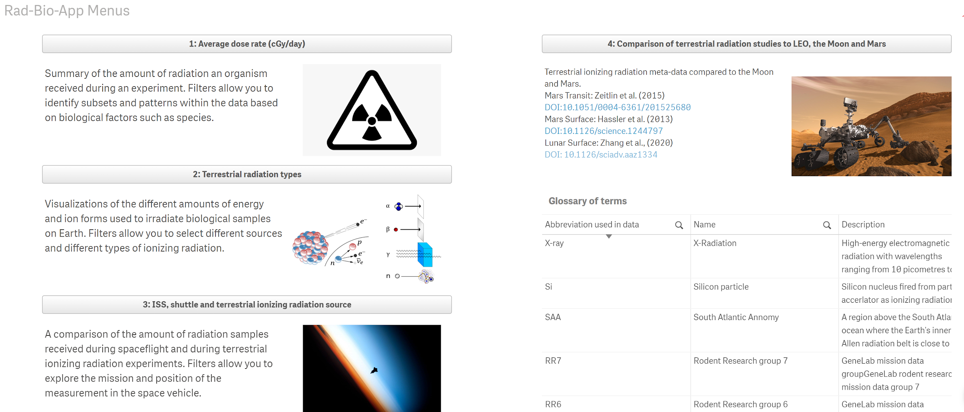
If the data goes to a Qlik app, for example, can it use JSON?

Slide 20
Options for getting data into Qlik:
According to Qlik advertising, Qlik can take JSON from web APIs via “Qlik DataTransfer on Windows”. Looking into that, it says to manually make a .hen file
fails, cause Dr. Richard won’t want it as JSON data in Qlik anyway
Using an XML intermediate file (like HTML) is some peoples’ solution
fail
file.io to upload as a web file
fail, didn’t recognize CSV or JSON from file.io on Qlik
Also, a REST source would allow JSON uploads
fail, cause Dr. Richard won’t want it as JSON data in Qlik anyway
JSON to CSV converter
which I used! Seems to convert well in testing, but not sure what part of the data matters to Dr. Richard, so maybe I’m wrong

Slide 21
Conclusion-like
I have lots of data! Perhaps more importantly, a good way to get more data.
It’s in JSON, and a bunch of conversions off of JSON depending on what could be useful
Some tangents were explored and left open or stopped

Slide 22
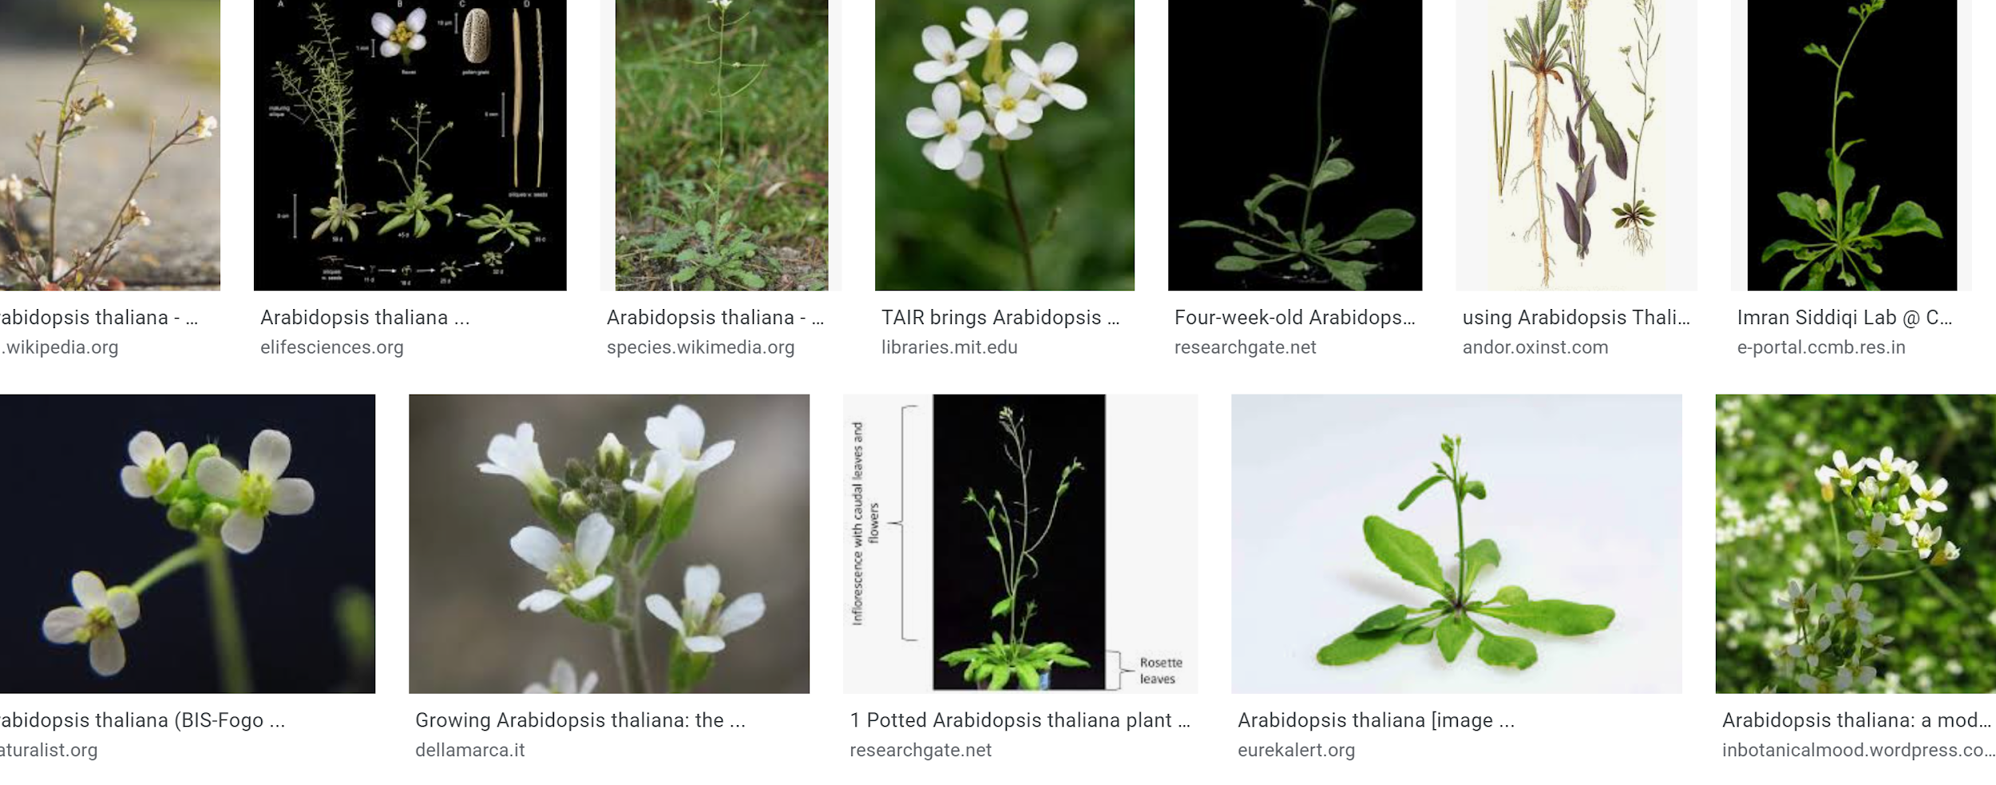
(sorry about the lack of botany, not exactly my field)
so here’s some pictures of Arabidopsis thaliana off Google

Slide 23
Thank you for your time!
(if interested, thorough notes can be found in my notes document)

